Slide 1
MADRID LIFESTYLE
José Javier Rueda, May 2020

Slide 2
Introduction
Lived in Madrid my whole life with my family. Currently looking for a place to move and live by myself.
Looking for a neighborhood that satisfies my necessities.
Personal interest.
Interest to real state companies.

Slide 3
Data Acquisition
Sources:
Neighborhoods: Wikipedia (https://es.wikipedia.org/wiki/Anexo:Barrios_administrativos_de_Madrid).
Geospatial information: manually from https://geocode.localfocus.nl/.
Venues: Foursquare API.
Cleaning:
Merging the two tables into one data frame.
Shape: 21 districts and 131 neighborhoods.
Change ‘,’ to ‘.’ and data types.

Slide 4
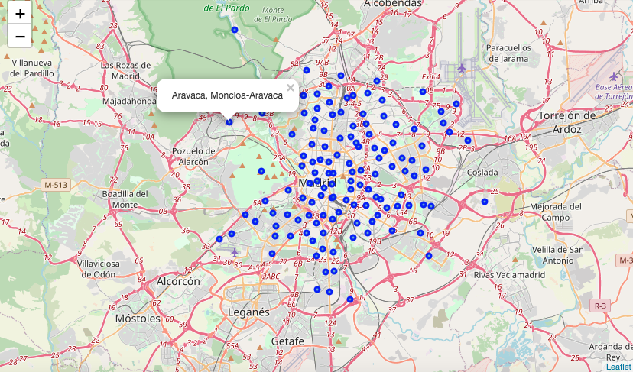
Data Acquisition

Slide 5
Data Analysis
Exploring data frame:
Limit 100 venues per neighborhood.
Set a radius of 700 meters from the center of the neighborhood.
Total venues retrieved: 5535.
Unique venue categories: 296. Very rich selection!
Obtaining common venues:
One hot encoding: obtain the frequency of each category in each neighborhood.
Select the 5 most common categories per neighborhood.

Slide 6
Clustering
Model:
Methodology: k-means.
k=8, optimal value found by trial and error.
Results:
Cluster Label | Category
Cluster 0 | Tourists (hotels and coffee shops)
Cluster 1 | Food (restaurants and bars)
Cluster 2 | Mirasierra (outlier)
Cluster 3 | El Cañaveral (outlier)
Cluster 4 | Spanish restaurants (tapas)
Cluster 5 | Sports facilities
Cluster 6 | Casa de Campo (main park)
Cluster 7 | Residential (plazas and green areas)

Slide 7
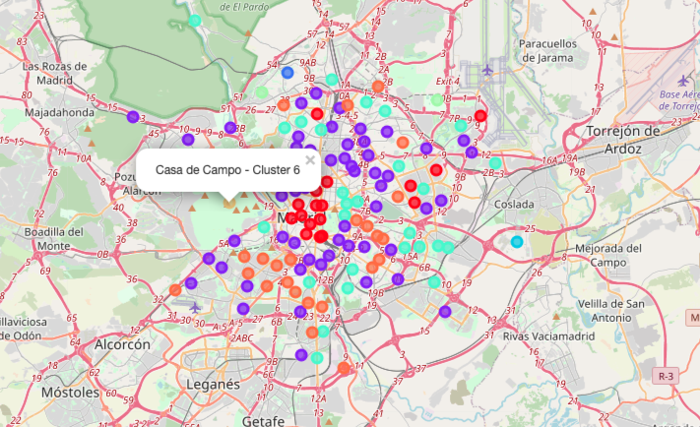
Clustering

Slide 8
Conclusions and Further work
Conclusions:
I would move from Goya (Cluster 4) to Estrella (Cluster 7).
Cluster 7 represents quiet neighborhoods with green areas and plazas.
Estrella is not far from my family home so it easy to visit them.
Further work:
Detect outliers.
Drop neighborhoods with a limited amount of venues, which introduce noise in the model.

Slide 9
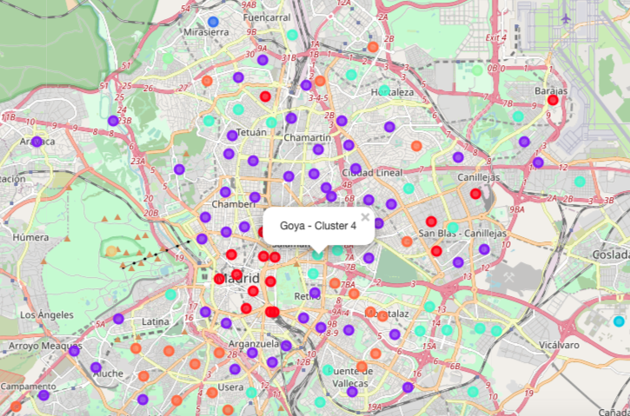
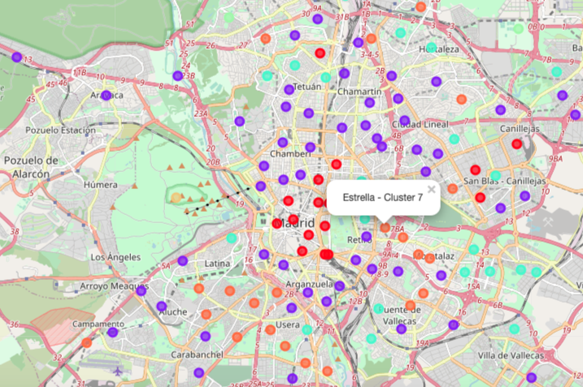
Conclusions and Further work

